Slide 1

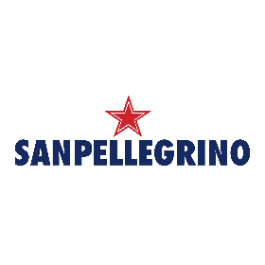
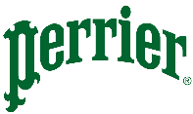





Marketing spend: San Pellegrino and Perrier are the top spenders among peers, with Perrier showing a remarkable YoY surge fueled entirely by online channels
overall_1_132519229906566328 columns_3_132519229968449503 6_1_132519231416735211 11_1_132519247474474653 17_1_132519247474823726 12_1_132520412060963870 21_1_132520412061440048
marketing-mix
Sparkling water
directional
San Pellegrino & Perrier increased spending in LTM, majorly invest in online channels
Social media is the preferred channel
Polar
Note: LTM is May’24-Apr’25; LLTM is May’23-Apr’24 | Source: Vivvix (Kantar), Pathmatics, SEMrush

Slide 2
Marketing channel mix: San Pellegrino and Perrier are outperforming peers with higher investments and a more diversified channel mix
overall_1_132519010464735897 columns_2_132519236063076276 30_1_132519235021977123 34_1_132519246744957858 37_1_132519246745177277 10_1_132524658155331479
marketing-mix
Sparkling water
directional
Online
Offline
Polar
Note: LTM is May’24-Apr’25; LLTM is May’23-Apr’24 | Source: Vivvix (Kantar), Pathmatics, SEMrush

Slide 3

Digital ads: San Pellegrino and Perrier lead peer investments with the most diversified channel mix, yet have room to improve efficiency by lowering their CPMs
overall_0_132234641713854426 columns_1_131849694517761216 6_1_132288352405399507 9_1_131849694513342530 25_1_132174689622401488 16_1_132234637570445797 10_1_132298120093994249
marketing-mix
Sparkling water
Directional
Polar
Note: YoY change: May’24-Apr’25 vs. May’23-Apr’24; *Cost per 1,000 impressions = CPM; Display/video ads are programmatically placed ads on websites or fixed buys/ deals with websites to place ads for the brand
Source: Pathmatics

